Slide 1
Introduction to SOSWalker
Central Monitoring System for CS1100

Slide 2
From One CS1100 to Many
Without SOSWalker
NECs CS1100 device can be used to monitor sensor statuses remotely.
But, if there are more than 1 CS1100, monitoring has to be done separately, logging in to each CS1100, one-by-one.
With SOSWalker
Possible to monitor & manage a number of CS1100 devices centrally.
Also, can compare information from many CS1100 devices.

Slide 3
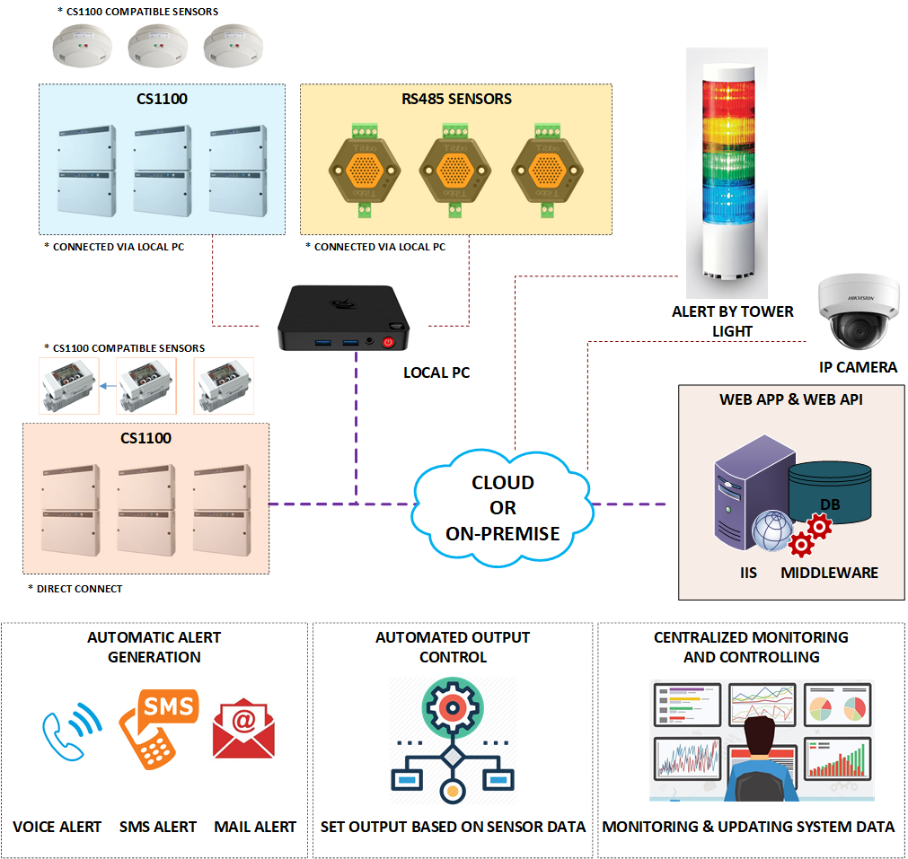
SOSWalker
Suitable for who is…
Looking for IoT, M2M platforms.
Currently has 1 CS1100 and wants to upgrade to many CS1100 devices.
Want a common platform to reduce operational & maintenance costs.
Can host the system with a cloud server, and as well as with an on-premise server.

Slide 4
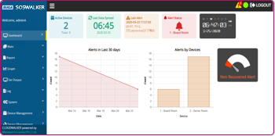
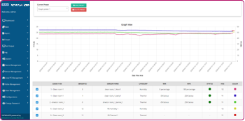
SOSWalker Special Features
Real-time monitoring of multiple sites
Data of many CS1100 devices displayed in one UI.
Data displayed is real-time and includes statuses, data & notifications.
Efficient management of data
Sensor data is automatically saved in server.
Data collection and displaying are customizable according to the user’s preference.
Dashboard
Graph (Real-time)

Slide 5
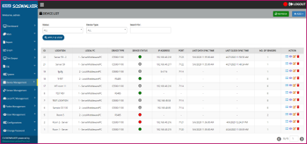
SOSWalker Special Features (Statuses)
Monitoring device status and connection status
Status of CS1100 and sensors
Connection of devices and local PCs
Status of the whole system
Device status
Local PC connection status

Slide 6
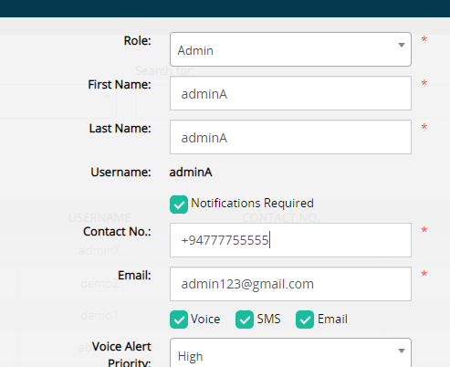
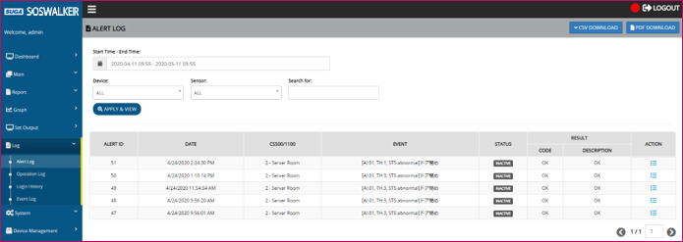
SOSWalker Special Features (Notifications)
Getting notifications of alerts occurred
Voice, SMS & email notifications
In case of on-premise
Internet connection is needed to send voice & SMS notifications.
Internally usable email server is needed to send email notifications.
Customizable user-wise
Prioritize the users to receive the notifications first
Notification settings
SMS
Alert log

Slide 7
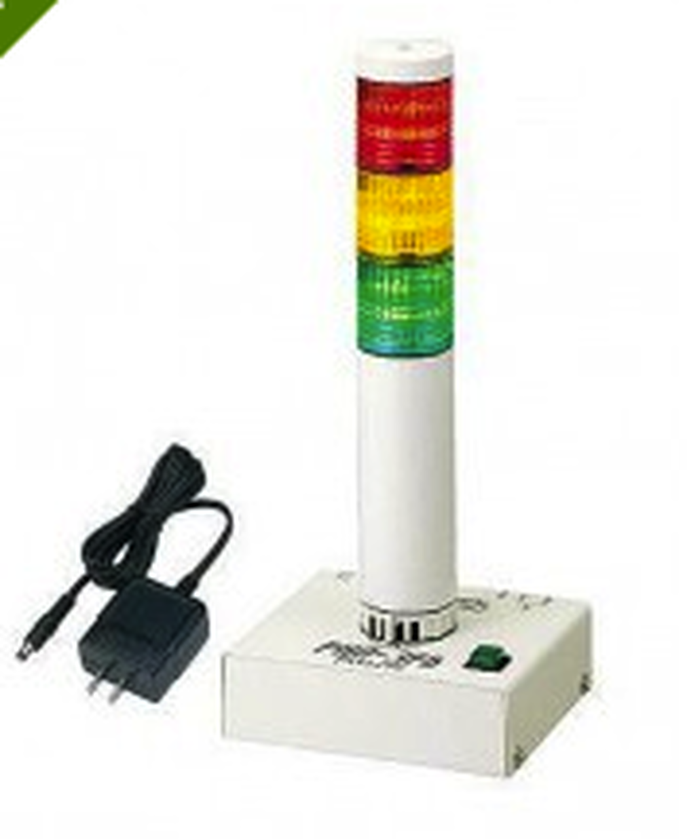
SOSWalker Special Features (Tower Light Support)
Can set tower light to light according to both of the following scenarios.
When an alert occurred in a sensor connected to a device.
We an alert occurred in any sensor connected to the SOSWalker system (This is useful for the administrators who monitor the whole system from a central location).
Tower light

Slide 8
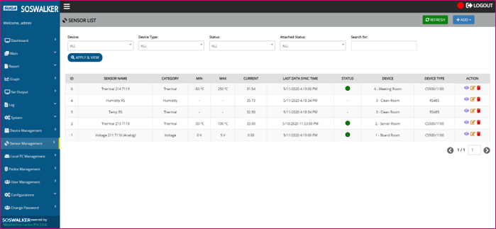
SOSWalker Special Features
Support for different types of sensors
Sensors that can be connected to CS1100
Sensors supported RS485 protocol
We are OK to display your company logo in the UIs, instead of the OEM name.
Sensor management

Slide 9
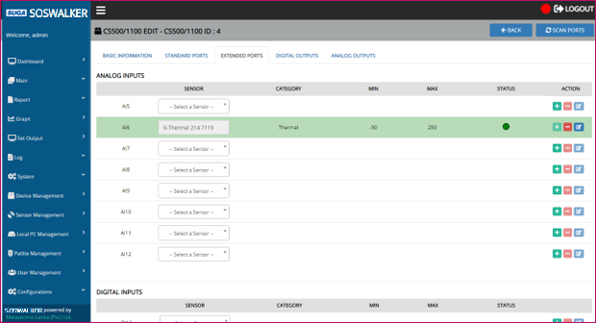
SOSWalker Special Features (Scan Ports)
Can search for CS1100 ports which sensors are attached, before assigning sensors from the SOSWalker system.
Scan ports

Slide 10
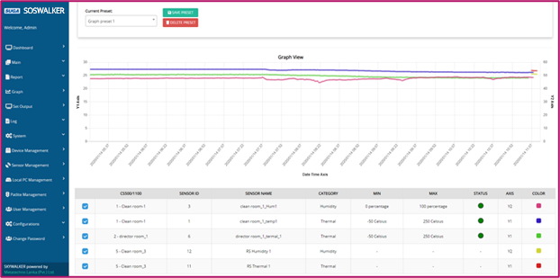
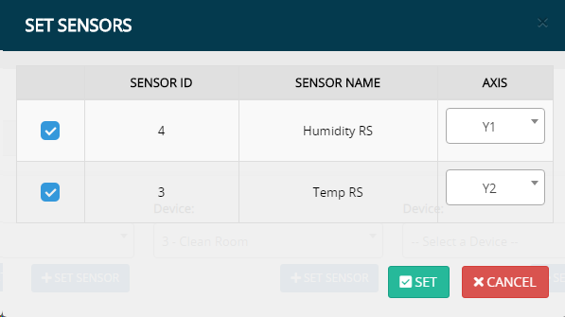
SOSWalker Special Features (Graphs)
Can obtain following graphs for sensors in many devices.
Real-time graph
Historical graph
Can display graphs based on 2 y-axes on left side & right side.
Can perform zoom & pan operations on graphs.
Can save selections as presets to generate graphs easily in future.
Graph
Set sensors & axes

Slide 11
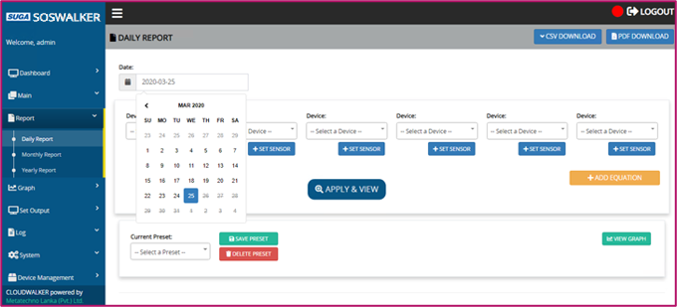
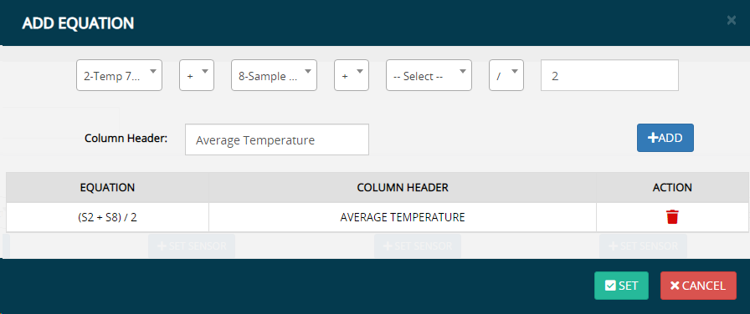
SOSWalker Special Features (Reports)
Can obtain following reports for sensors in many devices.
Daily
Monthly
Yearly
Can generate reports using maximum, minimum, average and accumulated sensor values.
Can perform operations on selected sensor values and get the results in the report.
Can save selections as presets to generate reports easily in future.
Daily report
Add equation

Slide 12
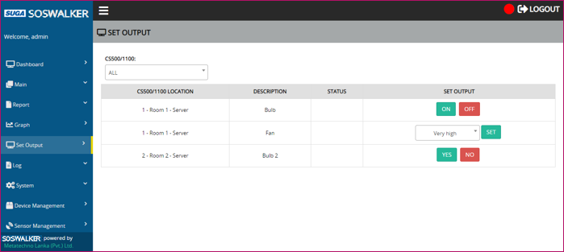
SOSWalker Special Features (Set Output)
Can set outputs…
Manually via the web app
Automatically based on the settings done in the web app
Can do the settings so that, if an alert occurred in a sensor connected to a CS1100, an output device connected to another CS1100 is automatically operated.
Set output

Slide 13
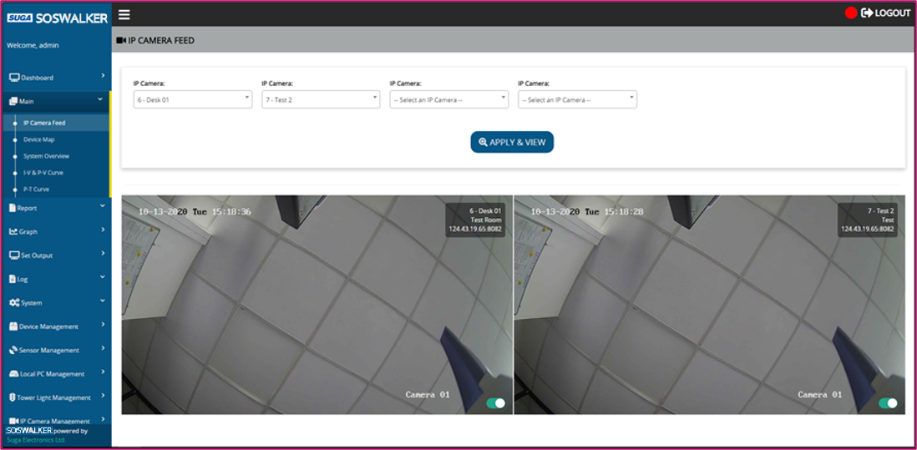
SOSWalker Special Features (IP Camera Feed)
IP camera feed can be viewed from Web App
Simultaneously up to 4 devices
Works for 3 IP camera models
For a system, IP cameras of a single model can be added without a limit.
Models supported
AXIS Q3515-LV
LILIN PZD6422EX3
Hikvision DS-2CD2145FWD-I(S)
IP camera feed

Slide 14
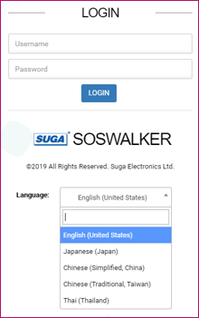
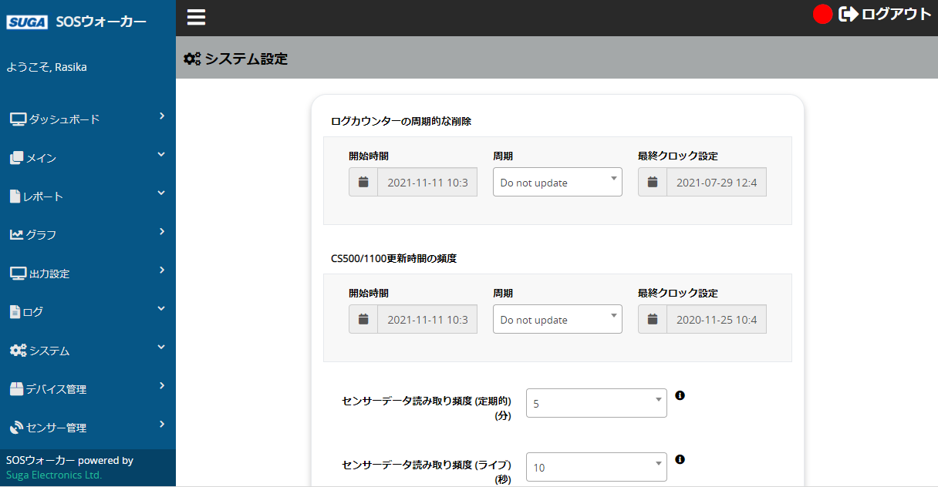
SOSWalker Special Features (Localization)
Language selection
Integrated localization support for 5 languages
English
Japanese
Chinese (Simplified, China)
Chinese (Traditional, Taiwan)
Thai
Plan to add more languages…
UIs in Japanese

Slide 15
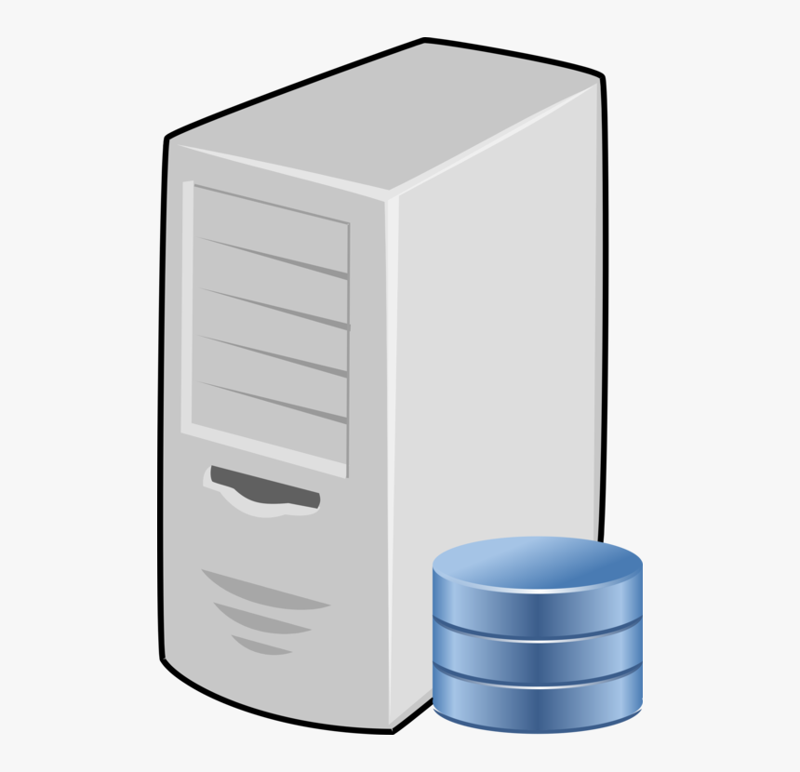
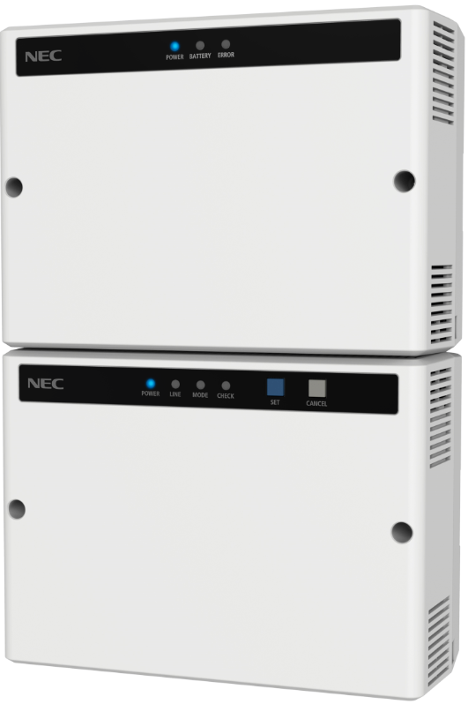
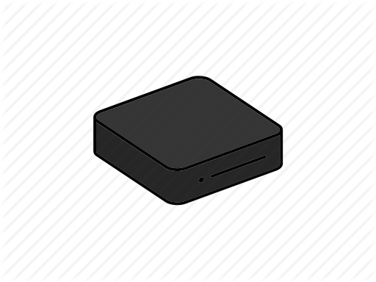
SOSWalker Special Features (Connect CS1100)
Server
Can connect CS1100 to SOSWalker system…
Directly to the server using a static IP address
Via a local PC
CS1100 1
(with static IP)
CS1100 2
(with non-static IP)
Local PC

Slide 16
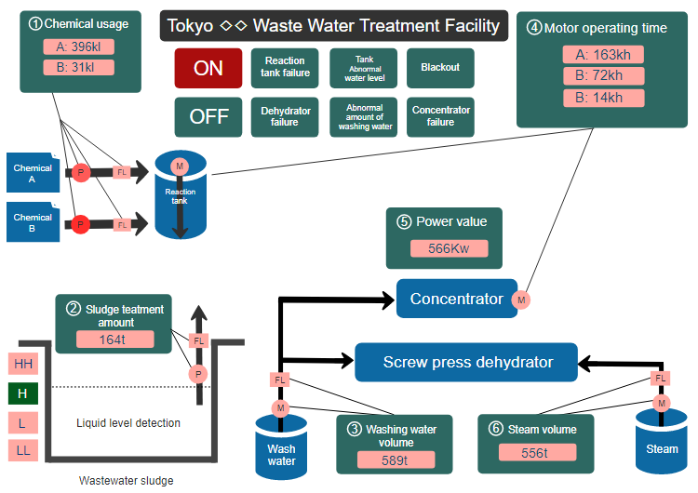
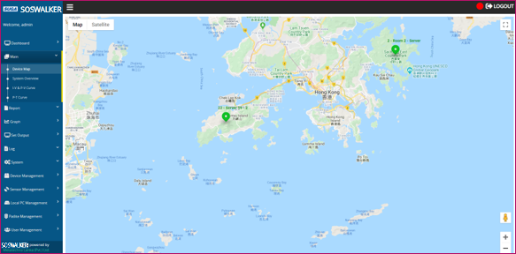
Providing Custom UIs
Will provide up to 2 additional custom UIs based on your preference, free of charge!
Samples are as follows…
Device map
System overview

Slide 17
System Configuration
There are 3 system configuration types.
One server configuration
Two server configuration
High-end configuration

Slide 18
System Configuration cont...
One server configuration
Server spec
CPU: 2 core
Memory: 8 GB
HDD: 500 GB
Local PC spec
CPU: i3
Memory: 8 GB
HDD: 500 GB
Device limitations
Max CS1100 (Direct): 15
Max CS1100 (Via local PC): 300
Max RS485 (Via local PC): 960
Max local PC: 30

Slide 19
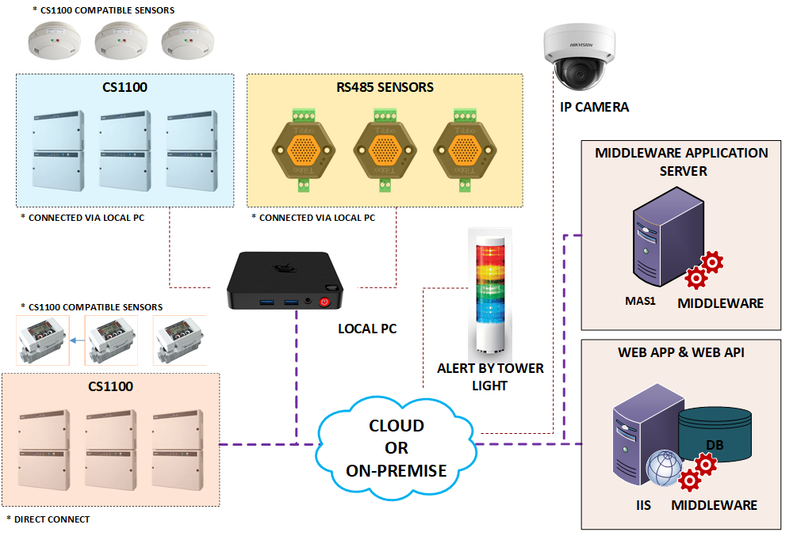
System Configuration cont...
Two server configuration
Middleware application server & web app/web API server spec
CPU: 2 core
Memory: 8 GB
HDD: 500 GB
Local PC spec
CPU: i3
Memory: 8 GB
HDD: 500 GB
Device limitations
Max CS1100 (Direct): 95
Max CS1100 (Via local PC): 300
Max RS485 (Via local PC): 960
Max local PC: 30

Slide 20
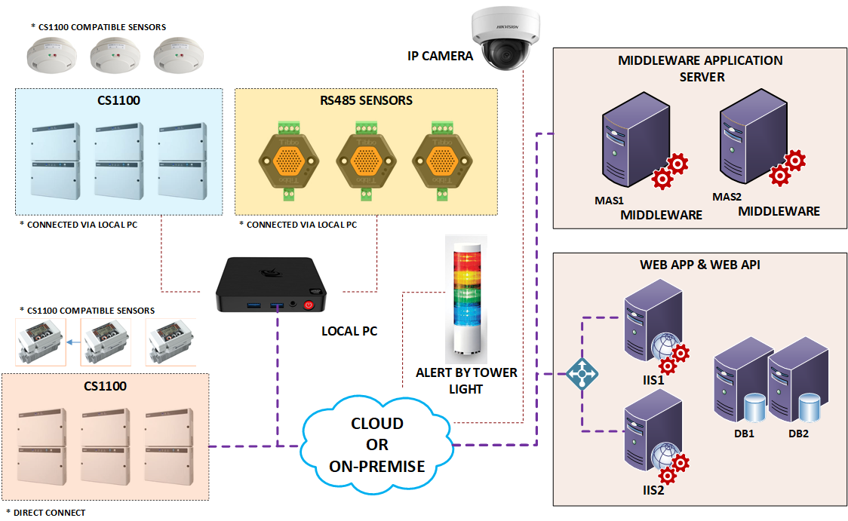
System Configuration cont...
High-end configuration
Middleware application servers' & web app/web API servers' spec
CPU: 2 core
Memory: 8 GB
HDD: 500 GB
Local PC spec
CPU: i3
Memory: 8 GB
HDD: 500 GB
Device limitations
Max CS1100 (Direct): 160
Max CS1100 (Via local PC): 2000
Max RS485 (Via local PC): 6400
Max local PC: 200
Middleware application servers can be increased to support more direct CS1100 (80 more CS1100 per server).

Slide 21
Business Process
When purchasing the SOSWalker system, following process will be followed…
Customer contacts SUGA and requests to purchase SOSWalker
SUGA gives the prices and other information to customer
Customer signs agreement with SUGA & pays an advance
SUGA develops customized UIs requested by customer

Slide 22
Business Process cont...
Customer does full payment to SUGA
Customer provides hardware & tools to deploy SOSWalker
SUGA deploys SOSWalker with purchased license amount
(5 CS1100 & 1 RS485 device license is included free)
SUGA provides support to customer according to the maintenance agreement

Slide 23
Architecture & Modules

Slide 24
SOSWalker Architecture Diagram

Slide 25
SOSWalker Modules
For details of modules,
Refer user manual’s ‘2.23 Services’ section.
For notification sending mechanism used by notification service,
Let’s refer user manual’s ‘4 Appendix B. Notification Sending Mechanism’ section.

Slide 26
System Installation

Slide 27
System Installation
Following 2 parts are there in system installation
Server installation
Middleware installation

Slide 28
System Installation (Server)
Server installation steps are the same for both cloud & on-premise setups.
Server installation has 3 main parts.
Web API installation
Web app installation
SignalR (Real-time notification) server installation

Slide 29
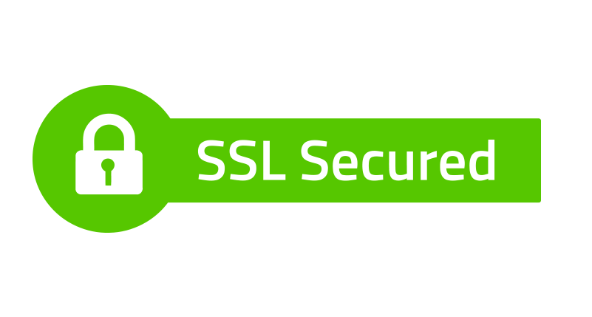
System Installation (Server) cont...
Web API installation
Install following software
OS (Windows Server 2016), Server (IIS Server 10), Server certificate, Database server (MySQL), Database management software (SQLYog), Database connector (MySQL connector), Microsoft .NET SDK, C++ redistributable packages (Visual C++ redistributable package)
Configure web API in IIS server
Configure to use SSL

Slide 30
System Installation (Server) cont...
Web app installation
Configure web app in IIS server
Add & set an application pool
Configure to use SSL
SignalR (Real-time notification) server installation
Add & set an application pool
Configure SignalR server app in IIS server
Configure to use SSL

Slide 31
System Installation (Middleware)
There are separate installers to install middleware to the server and the local PC as follows.
Server middleware installer (CS Installer)
Same installer can be used for both cloud & on-premise setups.
Local PC middleware installer (Local PC Installer)
Middleware installers

Slide 32
System Installation (Middleware) cont...
Server middleware installer (CS Installer)
Need to enter MySQL credentials at installation.
This will install following server services.
Mail watcher
Data watcher
Notification
This will also install following middleware services.
SignalR client
Data pull
Data push
Data acquisition
RS485
This will also install client license tool.

Slide 33
System Installation (Middleware) cont...
Local PC middleware installer (Local PC Installer)
Need to enter MySQL credentials at installation.
If middleware is to be installed to a separate server (not in the IIS configured one), this installer is used.
This will install following middleware services.
SignalR client
Data pull
Data push
Data acquisition
RS485

Slide 34
System Configuration

Slide 35
System Configuration
Following parts are there for system configuration.
License management
Client license tool
Admin license tool
Device
CS1100
RS485
Tower light
IP camera
Configuration tools
Server
Local PC

Slide 36
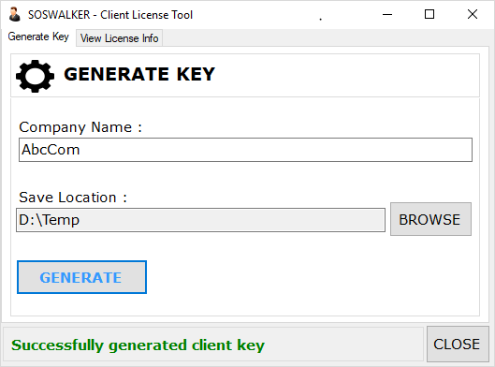
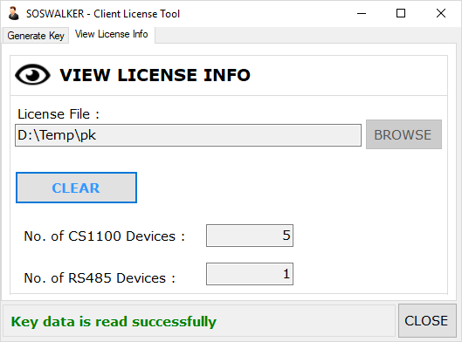
System Configuration (License Management – Client License Tool)
This is the tool needed for license management, from client’s side.
This is installed from middleware installer (CS Installer).
For details of this tool,
Let’s refer user manual’s ‘2.25 SOSWalker – Client License Tool’ section.
Generate key
View license info

Slide 37
System Configuration (License Management – Admin License Tool)
This is the tool needed for license management, from Suga administrator’s side.
As this is a tool related to Suga administrator, no need to configure at the client’s side.

Slide 38
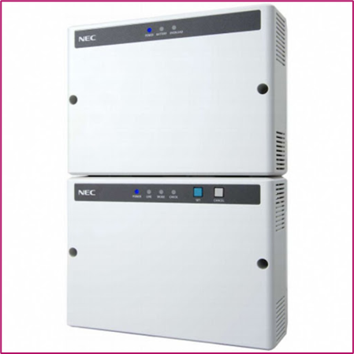
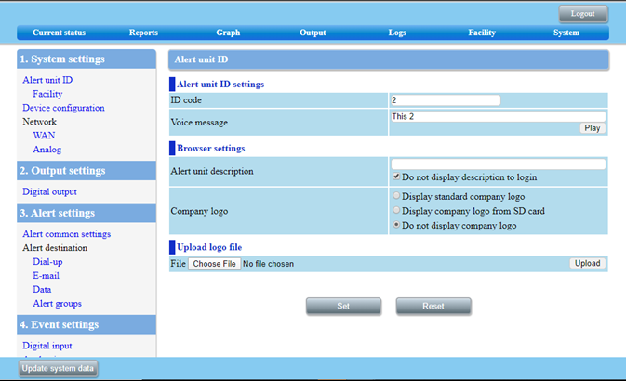
System Configuration (Device – CS1100)
Configuration steps
Physically connect sensor to CS1100
Connect to network assigning an IP address
Do settings in CS1100 side
For settings in CS1100 side,
Refer user manual’s ‘5 Appendix C. CS500/1100 Configurations’ section.
CS1100
CS1100 settings

Slide 39
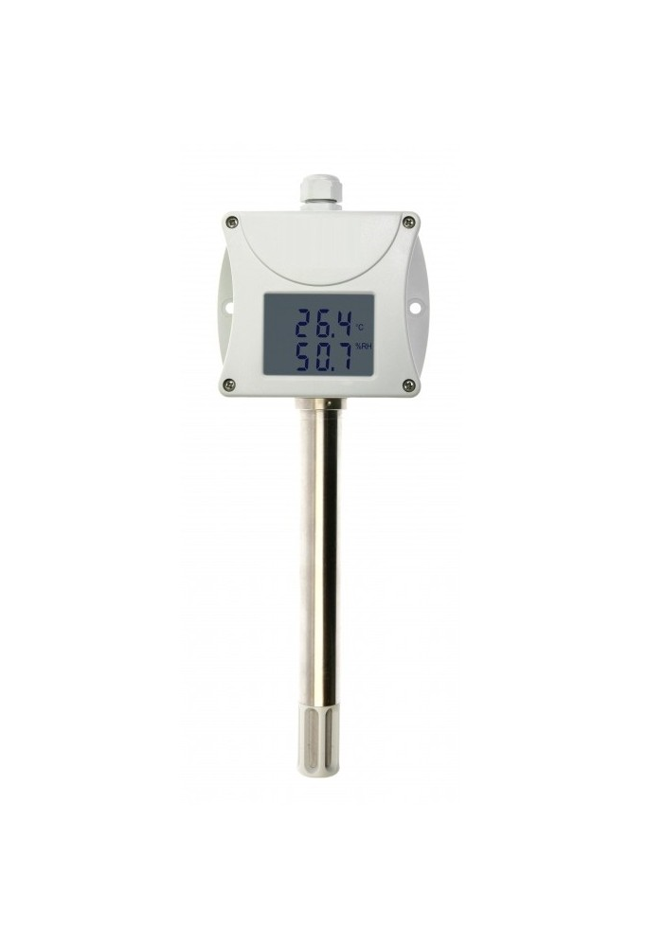
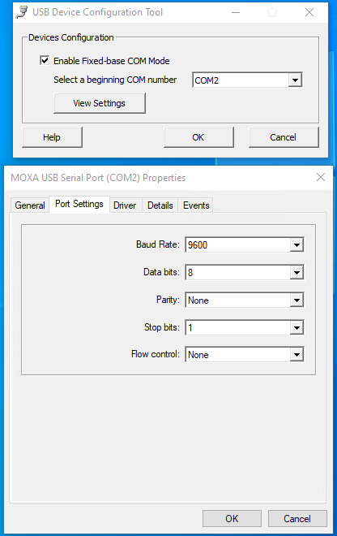
System Configuration (Device – RS485)
Configuration steps
RS485 sensor’s hardware setup
Physically connect sensor to local PC
Do settings in local PC side
RS485 sensor
RS485 settings

Slide 40
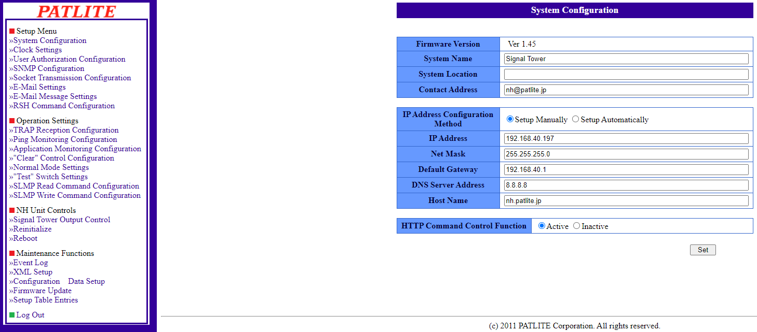
System Configuration (Device – Tower Light)
Configuration steps
Connect to network assigning an IP address
Do settings in tower light side
Tower light settings

Slide 41
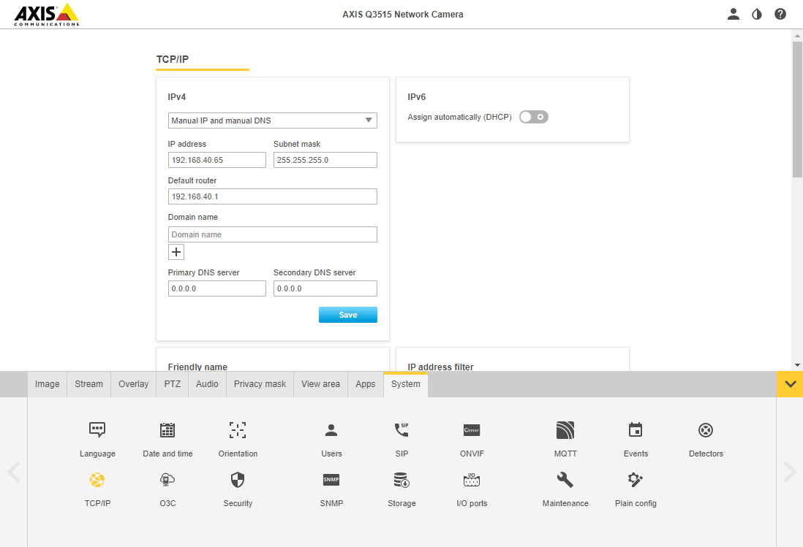
System Configuration (Device – IP Camera)
Configuration steps
Connect to network assigning an IP address
Do settings in IP camera side
IP camera settings

Slide 42
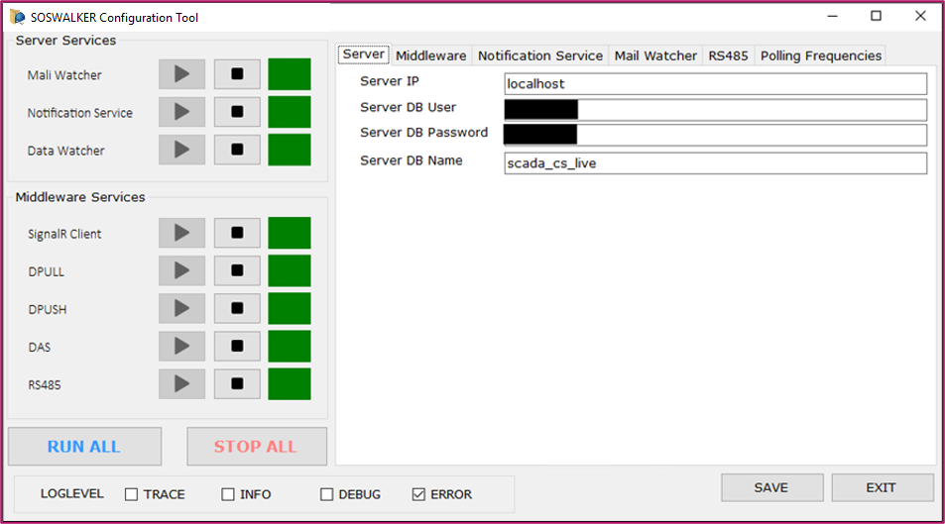
System Configuration (Configuration Tool – Server)
Tool’s functionalities
Service start / stop (server and middleware)
System-wide log level settings
System related configurations
Server
Middleware
Notification service
Mail watcher
RS485
Polling frequencies (server and middleware)
For details, refer user manual’s ‘2.24 SOSWalker Configuration Tool‘ section.
SOSWalker configuration tool (server)

Slide 43
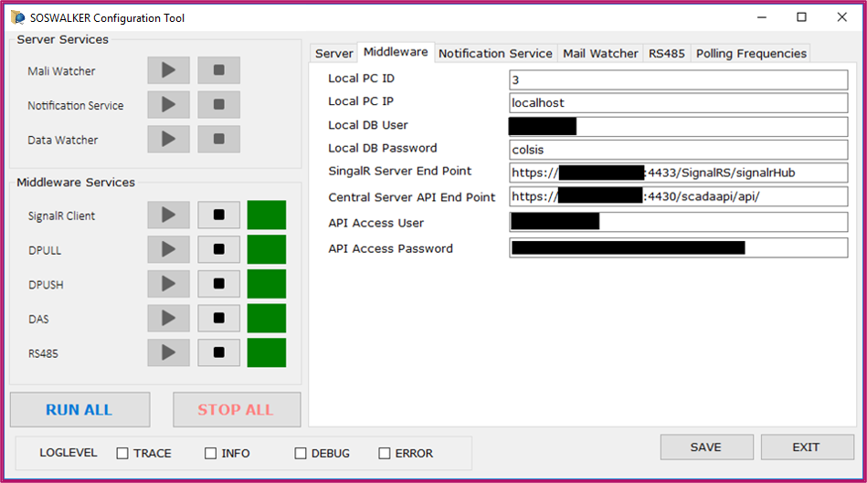
System Configuration (Configuration Tool – Middleware)
Tool’s functionalities
Service start / stop (middleware only)
System-wide log level settings
System related configurations
Middleware
RS485
Polling frequencies (middleware only)
For details, refer user manual’s ‘2.24 SOSWalker Configuration Tool‘ section.
SOSWalker configuration tool (local PC)

Slide 44
Thank You!

