Slide 1
Introduction to Cloudwalker
Central Monitoring System for calsos

Slide 2

From One Calsos to Many
Without Coludwalker
NECs Calsos device can be used to monitor sensor statuses remotely.
But, if there are more than 1 Calsos, monitoring has to be done separately, logging in to each Calsos, one-by-one.
With Cloudwalker
Possible to monitor & manage a number of Calsos devices centrally.
Also, can compare information from many Calsos devices.

Slide 3
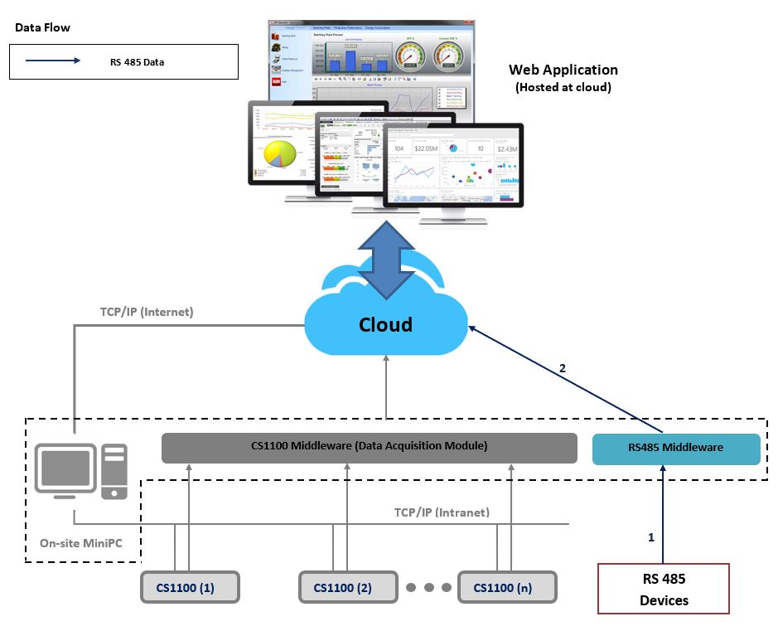
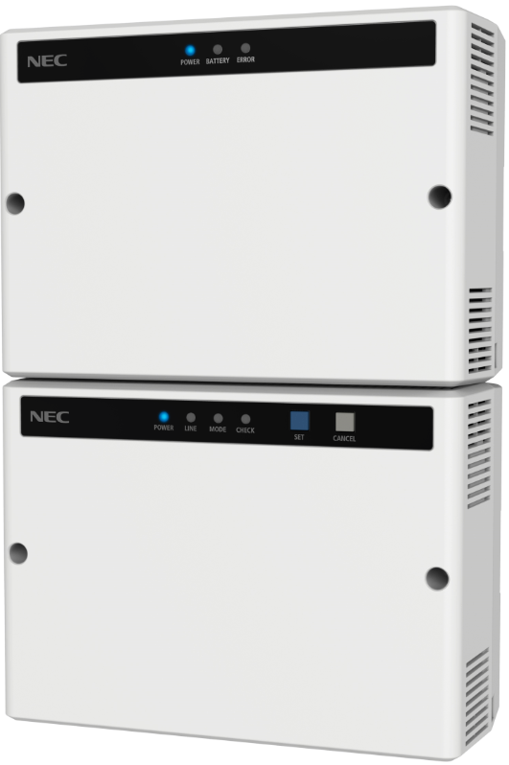

Cloudwalker
Suitable for who is…
  Looking for IoT, M2M platforms.
  Currently has 1 Calsos and wants to upgrade to many Calsos devices.
  Want a common platform to reduce operational & maintenance costs.
Can host the system with a cloud server, and as well as with an on-premise server (Image shows the cloud version).

Slide 4
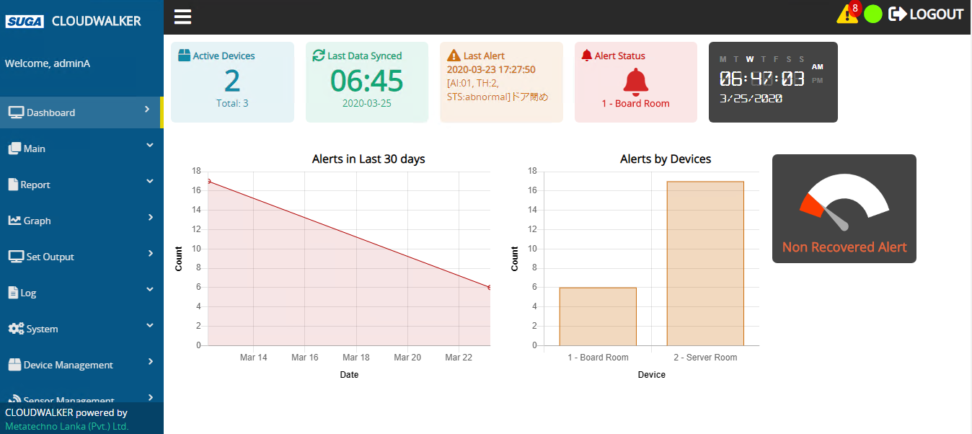
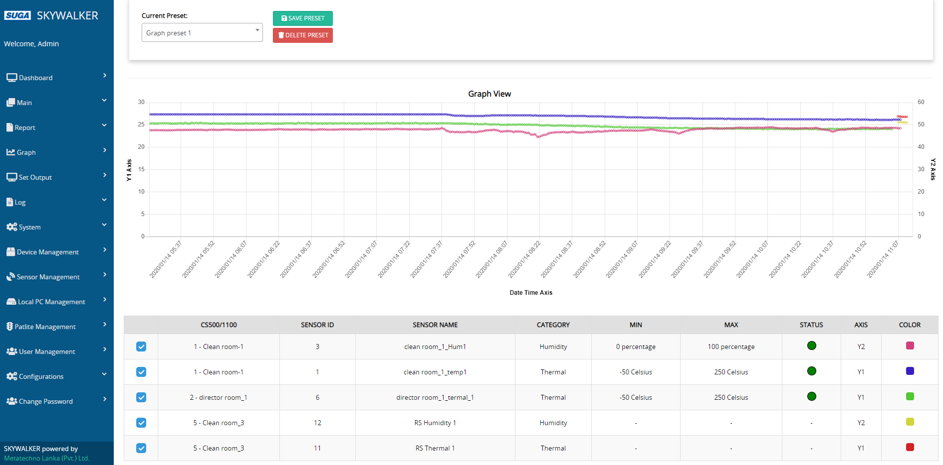
Cloudwalker Special Features
Real-time monitoring of multiple sites
  Data of many Calsos devices displayed in one UI.
  Data displayed is real-time and includes statuses, data & notifications.
Efficient management of data
  Sensor data is automatically saved in server.
  Data collection and displaying are customizable according to the user’s preference.
Dashboard
Graph (Real-time)

Slide 5
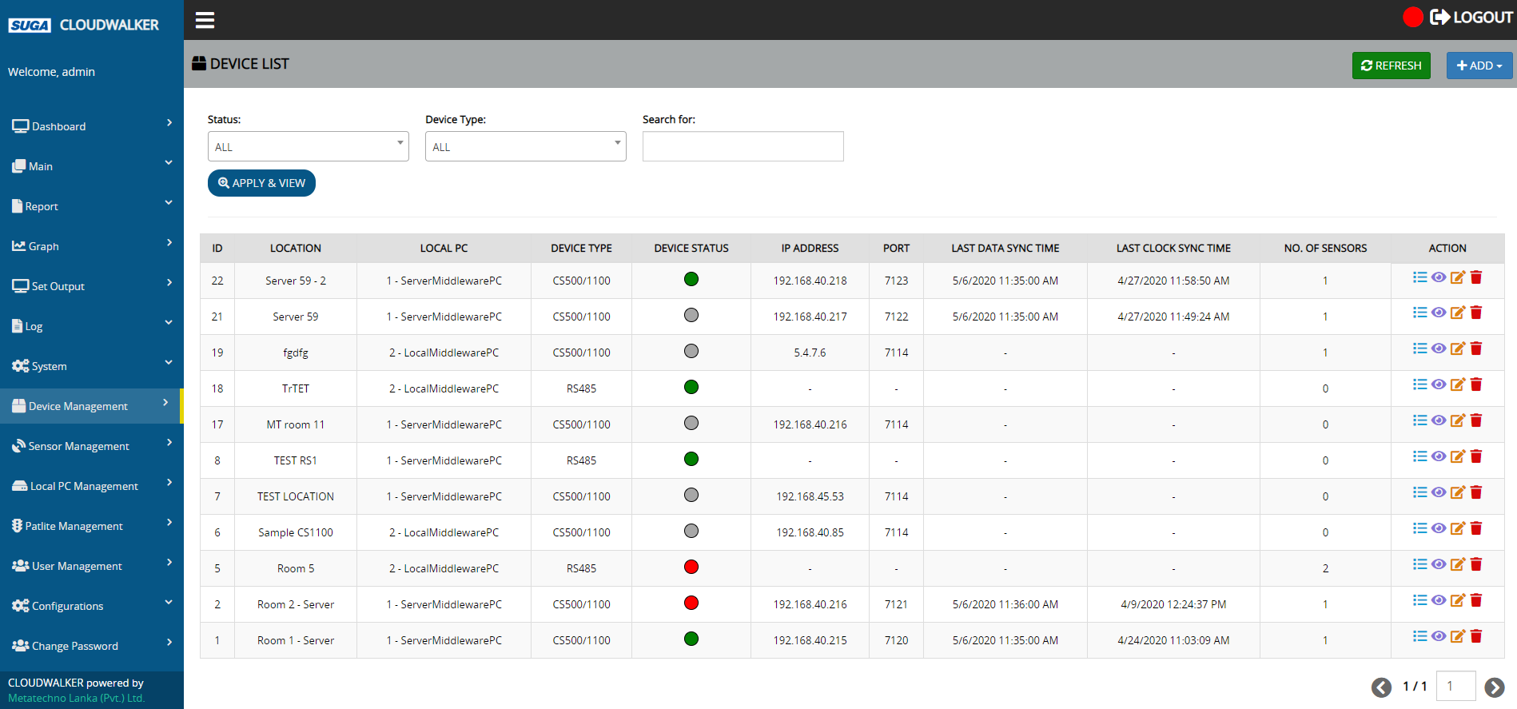
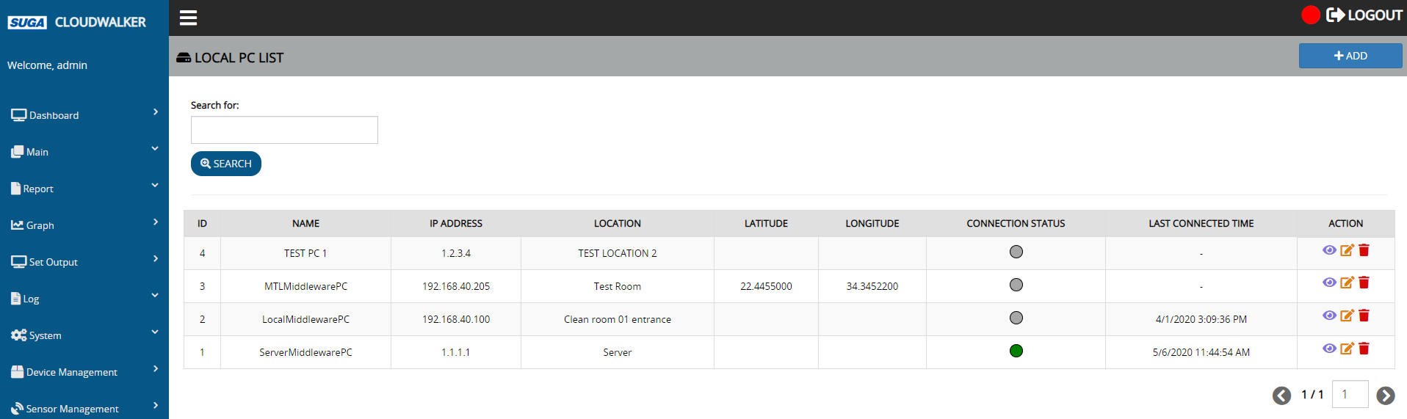
Cloudwalker Special Features (Statuses)
Monitoring device status and connection status
  Status of Calsos and sensors
  Connection of devices and local PCs
  Status of the whole system
Device status
Local PC connection status

Slide 6
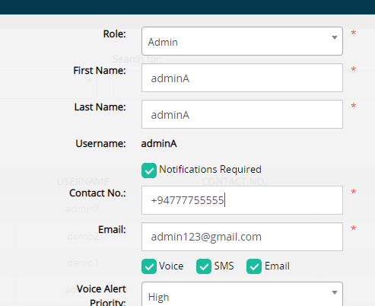
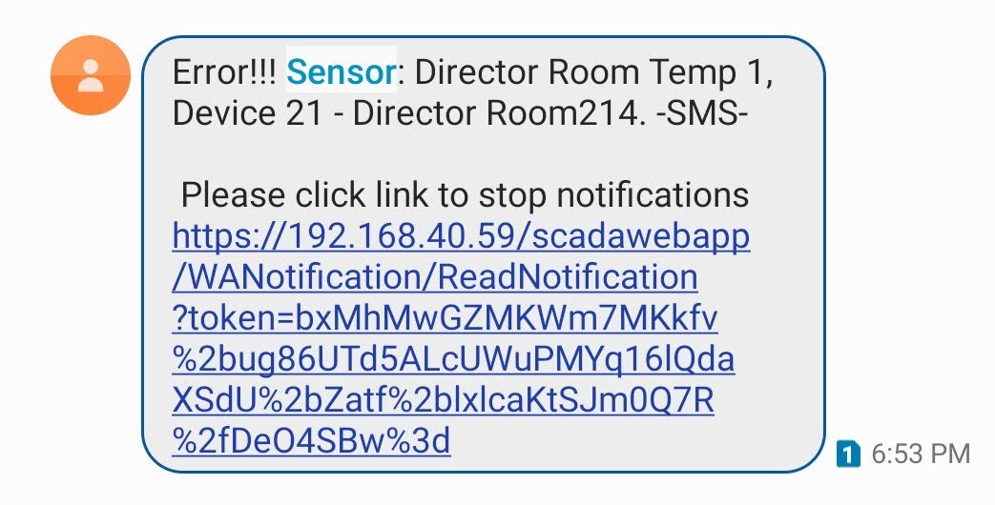
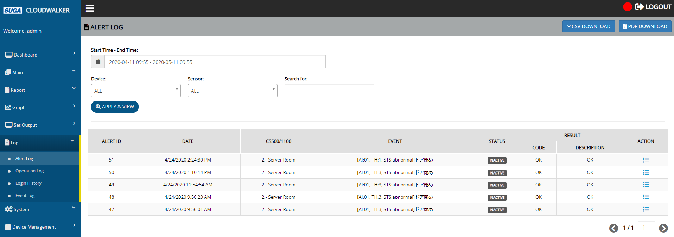
Cloudwalker Special Features (Notifications)
Getting notifications of alerts occurred
  Voice, SMS & email notifications
  Customizable user-wise
  Prioritize the users to receive the notifications first
Notification settings
SMS
Alert log

Slide 7
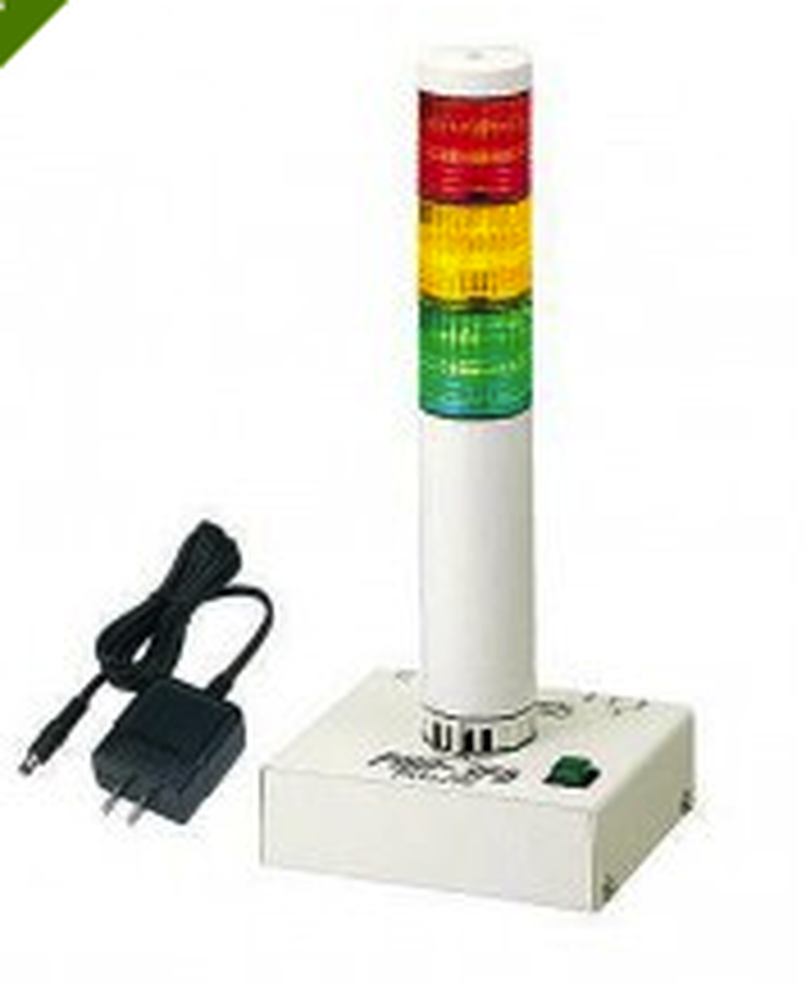
Cloudwalker Special Features (Patlite Support)
Can set Patlites to light according to both of the following scenarios.
  When an alert occurred in a sensor connected to a device.
  We an alert occurred in any sensor connected to the Cloudwalker system (This is useful for the administrators who monitor the whole system from a central location).
Patlite

Slide 8
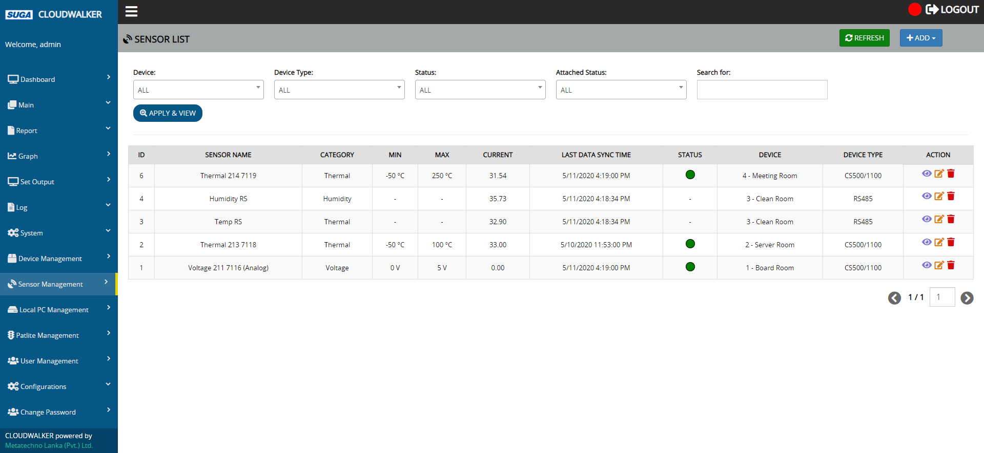
Cloudwalker Special Features
Support for different types of sensors
  Sensors that can be connected to Calsos
  Sensors supported RS485 protocol
We are OK to display your company logo in the UIs, instead of the OEM name.
Sensor management

Slide 9
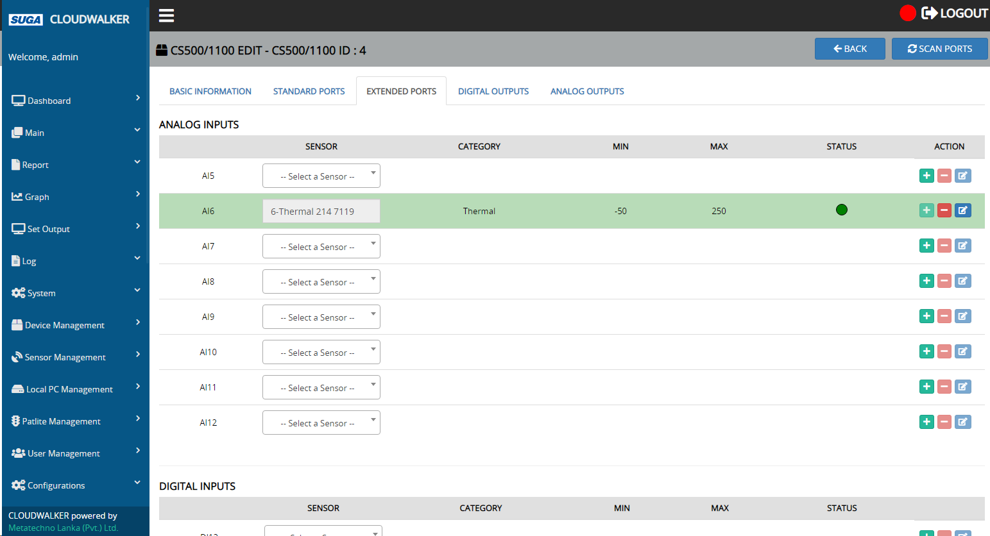
Cloudwalker Special Features (Scan Ports)
Can search for Calsos ports which sensors are attached, before assigning sensors from the Cloudwalker system.
Scan ports

Slide 10
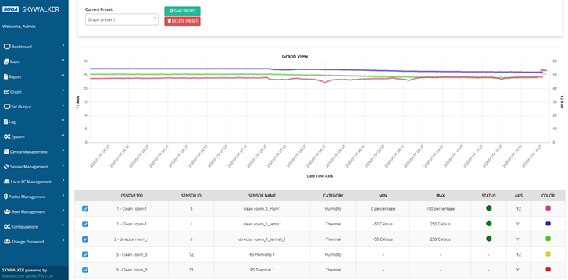
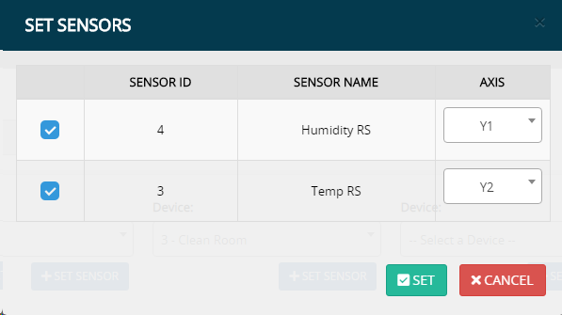
Cloudwalker Special Features (Graphs)
Can obtain following graphs for sensors in many devices.
  Real-time graph
  Historical graph
Can display graphs based on 2 y-axes on left side & right side.
Can perform zoom & pan operations on graphs.
Can save selections as presets to generate graphs easily in future.
Graph
Set sensors & axes

Slide 11
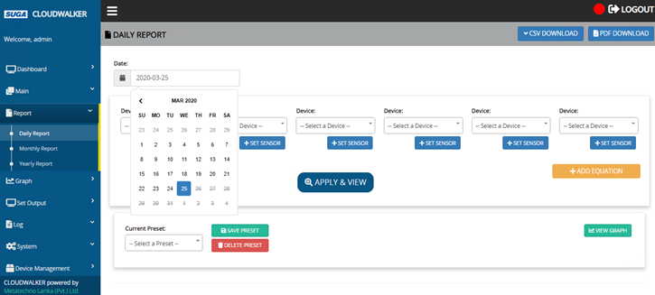
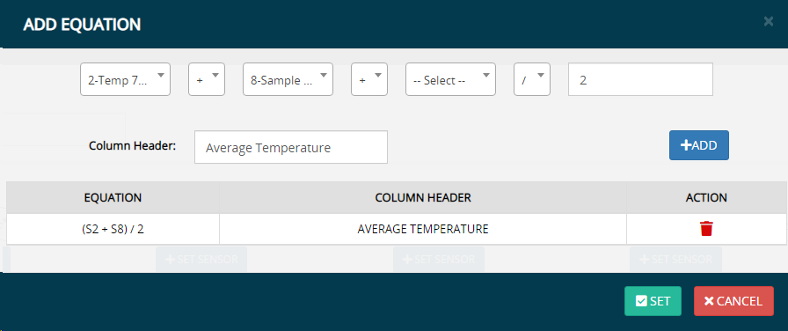
Cloudwalker Special Features (Reports)
Can obtain following reports for sensors in many devices.
  Daily
  Monthly
  Yearly
Can generate reports using maximum, minimum, average and accumulated sensor values.
Can perform operations on selected sensor values and get the results in the report.
Can save selections as presets to generate reports easily in future.
Daily report
Add equation

Slide 12
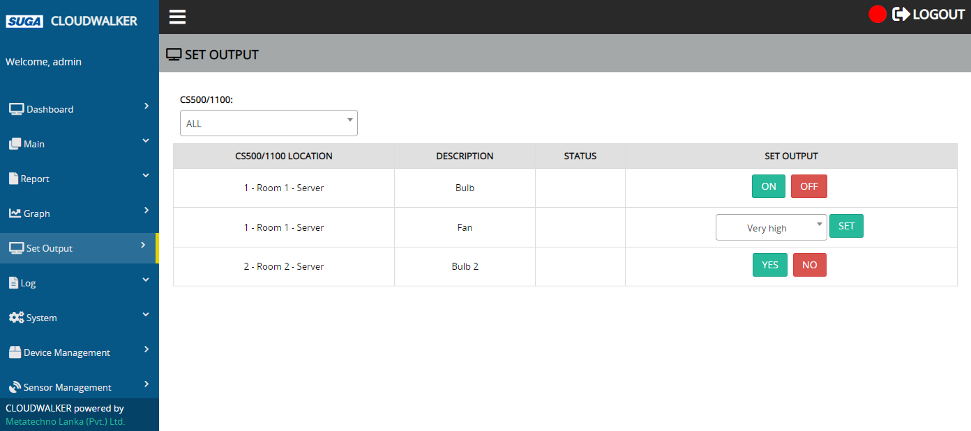
Cloudwalker Special Features (Set Output)
Can set outputs…
  Manually via the web app
  Automatically based on the settings done in the web app
Can do the settings so that, if an alert occurred in a sensor connected to a Calsos, an output device connected to another Calsos is automatically operated.
Set output

Slide 13
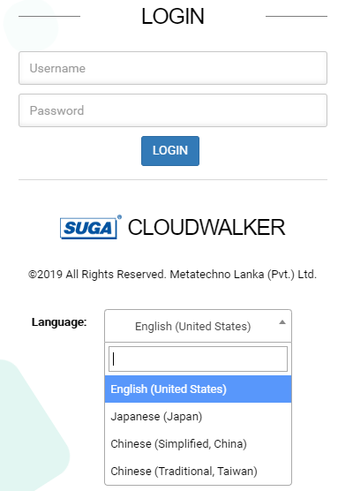
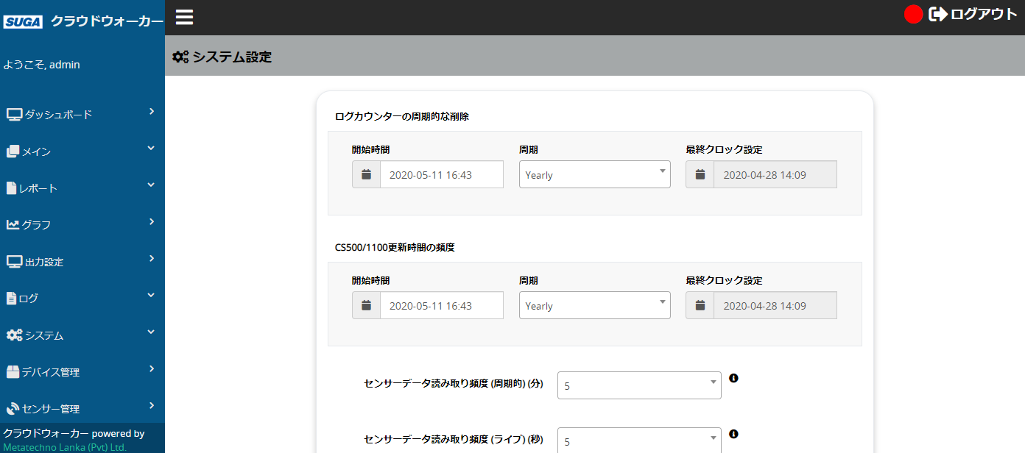
Cloudwalker Special Features (Localization)
Language selection
Integrated localization support for 4 languages
  English
  Japanese
  Chinese (Simplified, China)
  Chinese (Traditional, Taiwan)
Plan to add more languages…
UIs in Japanese

Slide 14

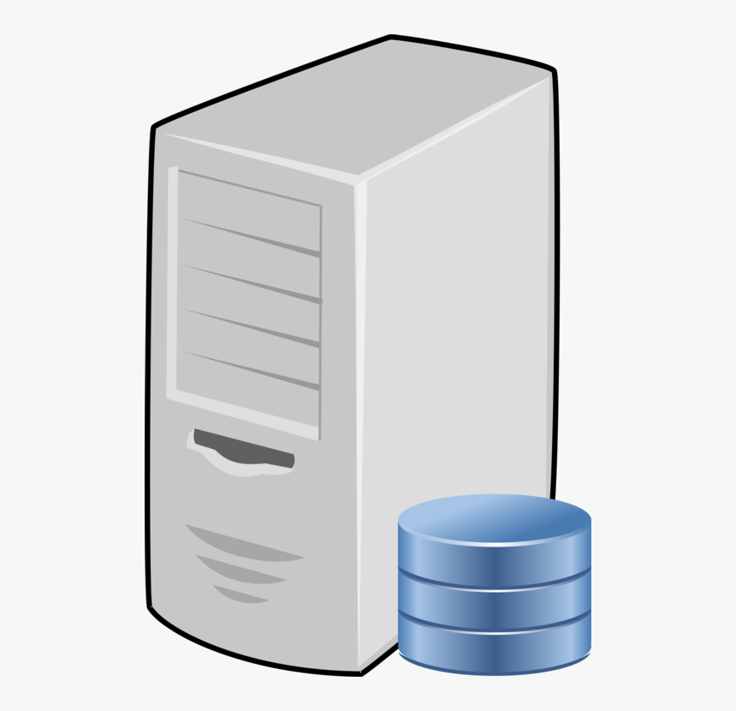
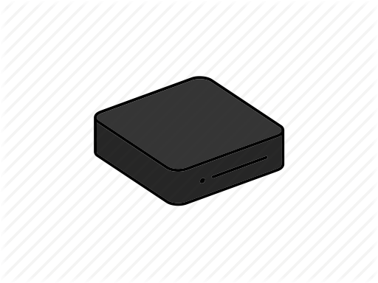
Cloudwalker Special Features (Connect Calsos)
Server
Can connect Calsos to Cloudwalker system…
  Directly to the server using a static IP address
  Via a local PC
Calsos 1
(with static IP)
Calsos 2
(with non-static IP)
Local PC

Slide 15
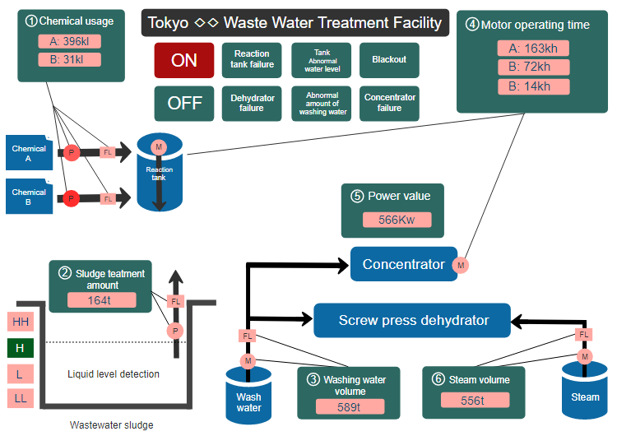
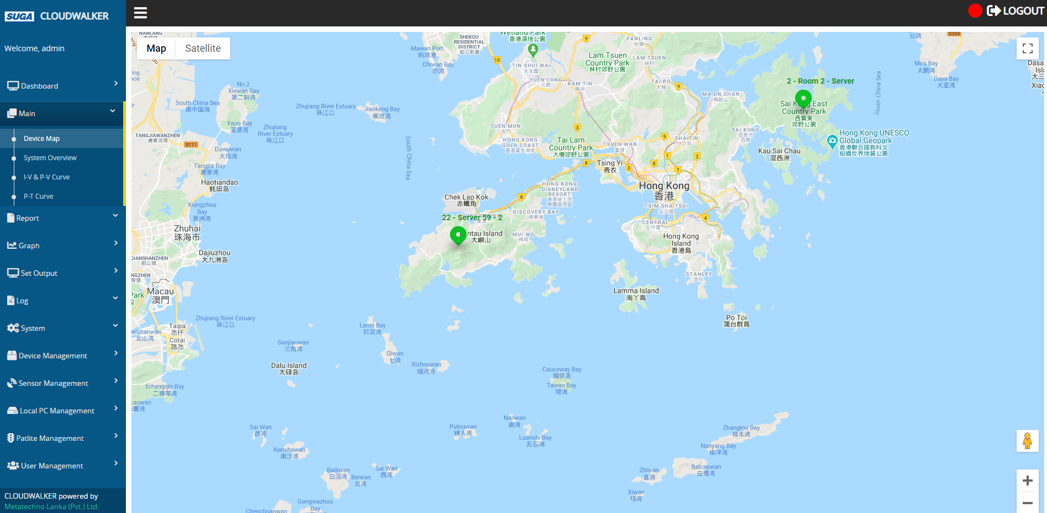
Providing Custom UIs
Will provide up to 2 additional custom UIs based on your preference, free of charge!
Samples are as follows…
Device map
System overview

Slide 16
Business Process
When purchasing the Cloudwalker system, following process will be followed…
Customer contacts SUGA and requests to purchase Cloudwalker
SUGA gives the prices and other information to customer
Customer signs agreement with SUGA & pays an advance
SUGA develops customized UIs requested by customer

Slide 17
Business Process cont...
Customer does full payment to SUGA
Customer provides hardware & tools to deploy Cloudwalker
SUGA deploys Cloudwalker with purchased license amount
SUGA provides support to customer according to the maintenance agreement

Slide 18
System Installation (Server)
Server installation steps are the same for both cloud & on-premise setups.
Server installation has 3 main parts.
  Web API installation
  Web app installation
  SignalR (Real-time notification) server installation

Slide 19




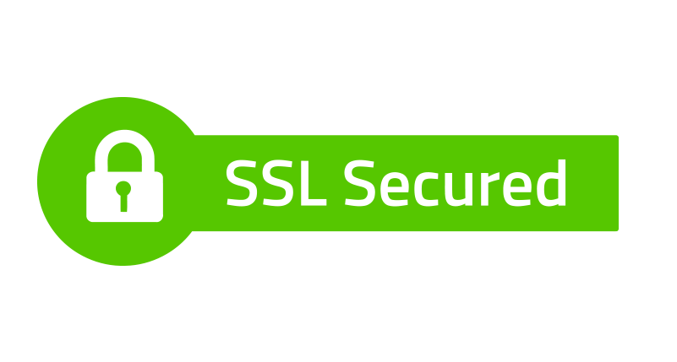
System Installation (Server) cont...
Web API installation
  Install following software
    OS (Windows Server 2016), Server (IIS Server 10), Server certificate, Database server (MySQL), Database management software (SQLYog), Database connector (MySQL connector), Microsoft .NET SDK, C++ redistributable packages (Visual C++ redistributable package)
  Configure web API in IIS server
  Configure to use SSL

Slide 20
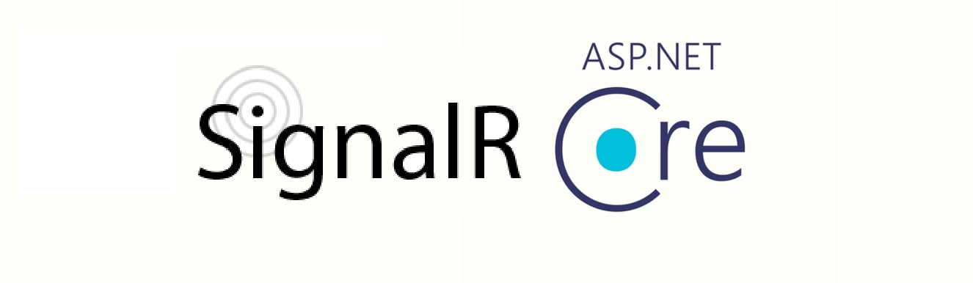
System Installation (Server) cont...
Web app installation
  Configure web app in IIS server
  Add & set an application pool
  Configure to use SSL
SignalR (Real-time notification) server installation
  Add & set an application pool
  Configure SignalR server app in IIS server
  Configure to use SSL

Slide 21

System Installation (Middleware)
There are separate installers to install middleware to the server and the local PC as follows.
  Server middleware installer (CS Installer)
    Same installer can be used for both cloud & on-premise setups.
  Local PC middleware installer (Local PC Installer)
Middleware installers

Slide 22
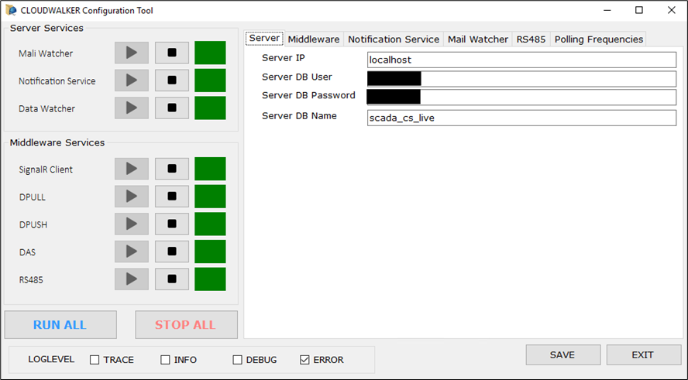
System Installation (Middleware) cont...
  Server middleware installer (CS Installer)
    Need to enter MySQL credentials at installation.
    This will install following server services.
      Mail watcher
      Data watcher
      Notification
    This will also install following middleware services.
      SignalR client
      Data pull
      Data push
      Data acquisition
      RS485
    After installation, operations & configurations can be done using the configuration tool.
Cloudwalker configuration tool (Server)

Slide 23
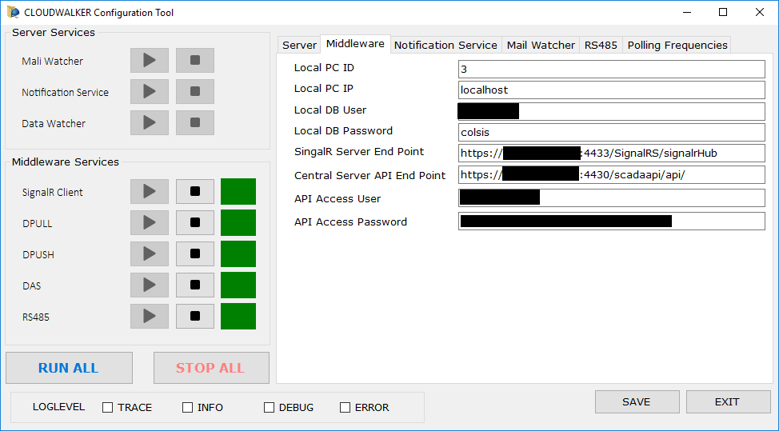
System Installation (Middleware) cont...
  Local PC middleware installer (Local PC Installer)
    Need to enter MySQL credentials at installation.
    If middleware is to be installed to a separate server (not in the IIS configured one), this installer is used.
    This will install following middleware services.
      SignalR client
      Data pull
      Data push
      Data acquisition
      RS485
    After installation, operations & configurations can be done using the configuration tool.
Cloudwalker configuration tool (Local PC)

Slide 24
Thank You!

